Slide 1
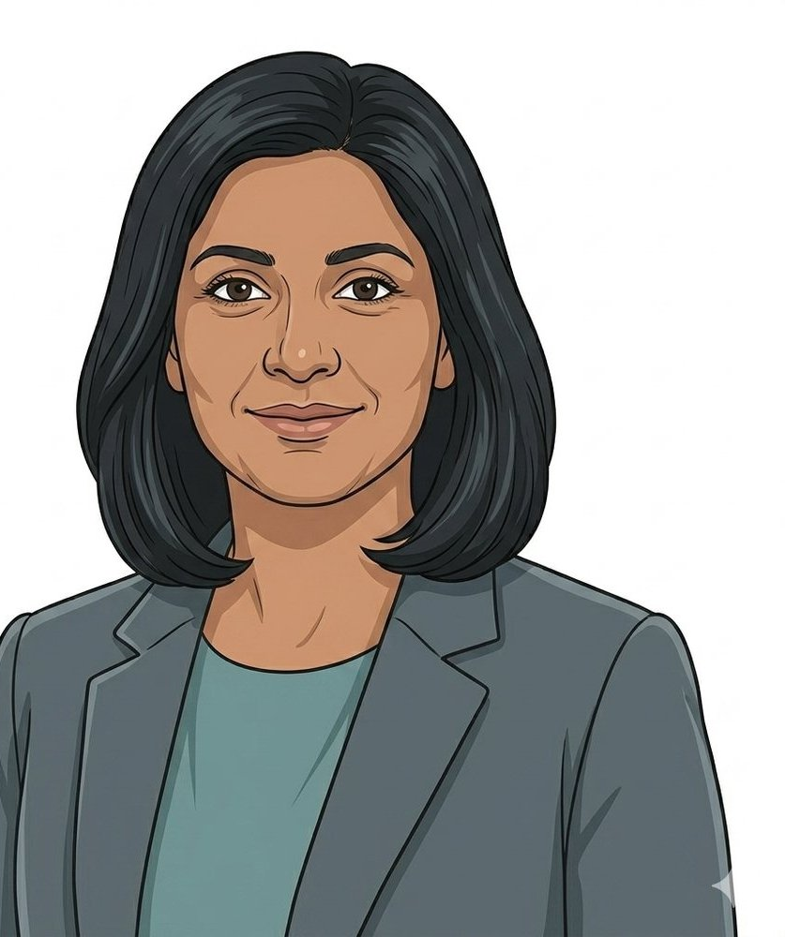

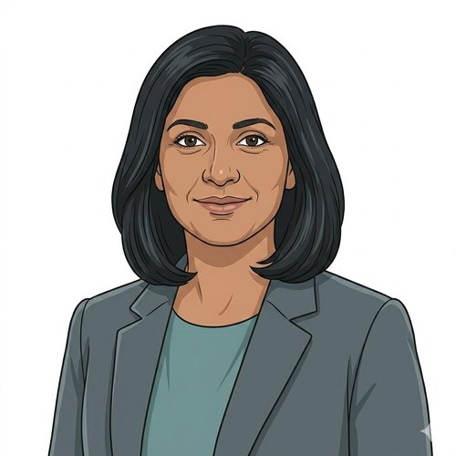
HEARTS AND MINDS · AN ICB/GP COMMISSIONER'S STORY THROUGH THE OPERATING MODEL
Anita.
Anita commissions the register. Not each appointment.
Anita commissions primary-care diagnostic monitoring for her Integrated Care Board. HbA1c annual reviews for the at-risk register run into tens of thousands annually across her patch. The register is growing as diabetes-prevention referrals build the risk cohort. Practice nurses are scarce. Phlebotomy appointments are the bottleneck. The cohort most likely to miss the appointment is the cohort most in need of the surveillance, shift workers, carers, deprived-ward residents. She has the QOF-adjacent funding architecture, no landed home-testing route, and a growing register. This is the story of one ICB/GP commissioner, one platform, one register-level arrangement, and an operating model that lets her commission at register scale rather than practice by practice.
Anita
ICB / GP commissioner · HomeTest HbA1c
Hearts and Minds · Anita's journey · HomeTest operating model · September 2026
Commercial positions are agreed in principle and remain subject to the live procurement.
Notes:
Anita's story, told through the operating model. Open on the person, not the pathway.

Slide 2
ANITA'S JOURNEY AT A GLANCE
Commission at register scale. So the annual HbA1c review cadence holds across the at-risk cohort without pulling clinic slots.
1
→
2
→
3
→
4
→
5
→
6
The brief · a register
One front door · the framework opens
Fit for the at-risk register · the questions the register has to answer
One call-off · commissioning the register
Live operation · kits out
The ICB paper · what the CMO sees
a cadence, a pathway to commission
results back
The framework opens
Signing, not procuring
What the members see
The questions standard answers don't solve
THE NORTH STAR
WHY ONE PLATFORM MATTERS TO HER
Commission at register scale. So the annual HbA1c review cadence holds across the at-risk cohort without pulling clinic slots.
One national arrangement. One register-level call-off. One platform every at-risk register patient in her ICB can flow through.
Anita
ICB/GP commissioners do not want a separate deal per GP practice. They want one register-level arrangement that every at-risk patient across their ICB flows through, regardless of which practice they attend. The operating model exists so the ICB commissions the annual HbA1c review at register level and each practice plugs in against a common national arrangement. Register-level commissioning is the North Star, because effort spent stitching practice-by-practice deals is effort not spent holding the cadence.
A bespoke HbA1c deal with one practice federation would buy one deployment. The next federation (or the next annual-review test the register carries) would mean another arrangement, another assurance set, another contract, another integration. The national arrangement means Anita commissions the register once, every practice in her ICB plugs into the same call-off, the same GP-record write-back answers the same questions, and the next primary-care annual-review test is an extension. The integration was done before she walked in.
ICB / GP commissioner · HomeTest HbA1c
Hearts and Minds · Anita's journey · HomeTest operating model · September 2026
Commercial positions are agreed in principle and remain subject to the live procurement.
2

Slide 3
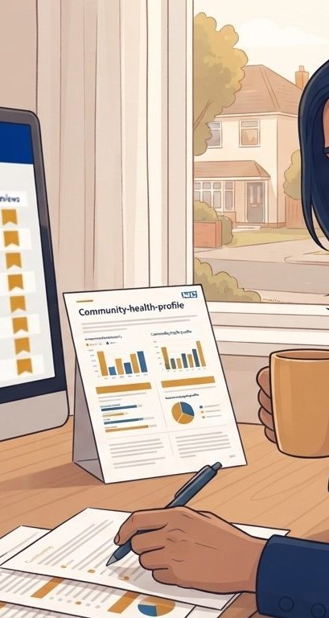
ANITA'S JOURNEY · STAGE 1 OF 6
01
The brief · a register
a cadence, a pathway to commission
Anita has an at-risk register across her ICB running into tens of thousands. Every one of them is due an annual HbA1c under QOF DM006 (for those on the diabetes register) or under the local diabetes-prevention pathway (for those on the pre-diabetes side). Practice nurses are scarce. Phlebotomy is the bottleneck. Register completion for the annual review is running below target across her deprived wards. The Chief Medical Officer wants the cadence to hold without pulling more nursing capacity. She has the QOF-adjacent funding architecture, the pathway design, and no landed home-testing route.
“The register is growing and the appointment barrier is holding it back. If I can move the sample-collection step to the patient's home, I hold the cadence without pulling more nursing capacity. What I don't have is a funding route that scales beyond one practice at a time.” Anita
WHAT THE MODEL IS DOING UNDERNEATH
THE OLD WAY
At-risk register data across her ICB. QOF DM006 completion rate by practice and by deprivation quintile. Diabetes Prevention Programme referral pipeline. Practice nurse capacity data. Phlebotomy waiting times across her primary-care footprint. The clinical case sits on capillary HbA1c with declared analytical performance against the DCCT-aligned reference. What's in front of Anita is a register-level commissioning arrangement, integration with each practice's existing review rhythm, and a call-off mechanism that doesn't require every practice to negotiate separately.
A bespoke deal with one practice federation. Bespoke QOF-linkage per federation. Bespoke DSA per federation. Bespoke MI feed per federation. Nine to twelve months from Board paper to first kit at the first practice. By the time the second federation is live, the register has grown again and the first cohort has drifted.
WHO ANITA'S CARE TEAM SEES Her ICB primary-care lead. Her ICB Chief Medical Officer. GP clinical directors across her federations. Her ICB IG lead. The diabetes prevention programme team who hold the pre-diabetes referral pipeline.
Hearts and Minds · Anita's journey · HomeTest operating model · September 2026
Commercial positions are agreed in principle and remain subject to the live procurement.
3
Notes:
Stage 1: The brief · a register. At-risk register data across her ICB. QOF DM006 completion rate by practice and by deprivation quintile. Diabetes Prevention Programme referral pipeline. Practice nurse capacity data. Phlebotomy waiting times across her primary-care footprint. The clinical case sits on capillary HbA1c with declared analytical performance against the DCCT-aligned reference. What's in front of Anita is a register-level commissioning arrangement, integration with each practice's existing review rhythm, and a call-off mechanism that doesn't require every practice to negotiate separately.

Slide 4
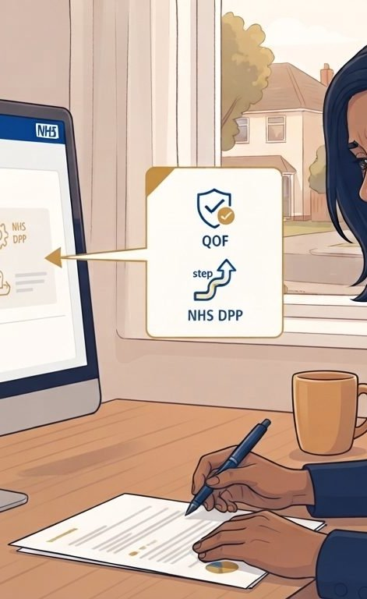
ANITA'S JOURNEY · STAGE 2 OF 6
02
One front door · the framework opens
The framework opens
She opens the framework. The HomeTest platform is admitted. The HbA1c configuration is live under UKAS-accredited capillary HbA1c with DCCT-aligned analytical performance. Suppliers listed against published call-off terms. QOF-linkage templates ready. GP-record integration patterns published. National pricing visible. No pathway to design from scratch.
“I expected to be writing a federation-by-federation deal. I'm looking at a register-level arrangement I can call off at ICB level. The heavy lifting was done before I logged in.” Anita
WHAT THE MODEL IS DOING UNDERNEATH
THE OLD WAY
The framework page. Admitted suppliers with UKAS-accredited capillary HbA1c performance. Standard ICB call-off terms. DSA, DPIA, privacy notice and clinical safety case starter templates pre-built. GP-record write-back documented against every major primary-care system. QOF DM006 linkage documented. Diabetes Prevention Programme referral pattern documented. The route is published; Anita just has to choose to take it.
A clean-sheet negotiation with the first federation to volunteer. Bespoke QOF-linkage. Bespoke IG. Bespoke MI. Three months per federation before the first contract draft. Six federations equals eighteen months of stitching.
WHO ANITA'S CARE TEAM SEES The platform's commissioner-engagement contact for the HbA1c configuration. Her ICB commercial team, sense-checking the register-level call-off route. GP clinical directors sense-checking how the pathway plugs into the annual review rhythm.
Hearts and Minds · Anita's journey · HomeTest operating model · September 2026
Commercial positions are agreed in principle and remain subject to the live procurement.
4
Notes:
Stage 2: One front door · the framework opens. The framework page. Admitted suppliers with UKAS-accredited capillary HbA1c performance. Standard ICB call-off terms. DSA, DPIA, privacy notice and clinical safety case starter templates pre-built. GP-record write-back documented against every major primary-care system. QOF DM006 linkage documented. Diabetes Prevention Programme referral pattern documented. The route is published; Anita just has to choose to take it.

Slide 5

ANITA'S JOURNEY · STAGE 3 OF 6
03
Fit for the at-risk register · the questions the register has to answer
The questions standard answers don't solve
Anita runs her register-specific questions against the framework. Does the capillary HbA1c analytical performance hold up against DCCT-aligned reference at the pre-diabetes decision points? What happens with the small proportion whose HbA1c trend triggers a diabetes diagnosis? Who holds the pathway-adjustment decision when the trend moves the wrong way? Does the reach work for shift workers, carers, deprived-ward residents, the cohorts most likely to miss the appointment?
“The register has clinical decision points. I need to know that home-collected HbA1c doesn't soften the trend detection at pre-diabetes threshold. If the analytical performance is fit for the register decision points, the pathway works. If it isn't, the register is dangerous.” Anita
WHAT THE MODEL IS DOING UNDERNEATH
THE OLD WAY
Her register-cohort questions against the framework's clinical documentation. UKAS-accredited capillary HbA1c analytical performance sheet with declared CV and MU at 42 mmol/mol and 48 mmol/mol decision points. Trend-detection reliability against DCCT reference. QOF DM006 auto-linkage documented. Diabetes Prevention Programme referral trigger workflow. Low-digital-literacy alternative entry route via practice reception. Unsafe-address pathway. Non-English-language support. The framework either answers these or it doesn't. Anita finds out before signing.
Six rounds of meetings per supplier to interrogate analytical performance and register mechanics per federation. Bespoke pathway design per federation. Pilot phase running into year two. Or, in the worst case, skip the register-specific interrogation and assume the general framework covers it. The pattern from bespoke deployments: analytical performance not fit for pre-diabetes decision points, register drift, DPP referrals dropped.
WHO ANITA'S CARE TEAM SEES Her ICB clinical lead for diabetes and long-term conditions. GP clinical directors from her federations. The platform's clinical safety case lead. Her ICB IG lead reviewing the register-level data flow. The Diabetes Prevention Programme lead.
Hearts and Minds · Anita's journey · HomeTest operating model · September 2026
Commercial positions are agreed in principle and remain subject to the live procurement.
5
Notes:
Stage 3: Fit for the at-risk register · the questions the register has to answer. Her register-cohort questions against the framework's clinical documentation. UKAS-accredited capillary HbA1c analytical performance sheet with declared CV and MU at 42 mmol/mol and 48 mmol/mol decision points. Trend-detection reliability against DCCT reference. QOF DM006 auto-linkage documented. Diabetes Prevention Programme referral trigger workflow. Low-digital-literacy alternative entry route via practice reception. Unsafe-address pathway. Non-English-language support. The framework either answers these or it doesn't. Anita finds out before signing.

Slide 6
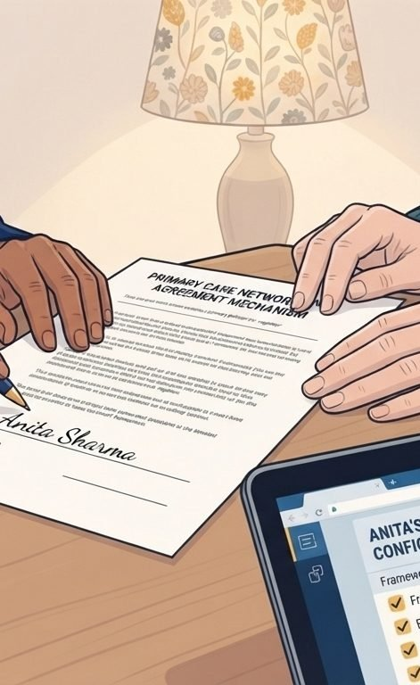
ANITA'S JOURNEY · STAGE 4 OF 6
04
One call-off · commissioning the register
Signing, not procuring
Anita commissions the register at ICB level. One call-off. Every practice in her ICB plugs in via a common commissioning schedule. Six weeks from brief to first live practice, not eighteen months. Payment via published call-off terms, QOF-linked where applicable. The procurement scar she carried in is not the arrangement she signed.
“I've commissioned pathways that took eighteen months of federation-by-federation stitching. The eighteen months I didn't spend stitching is the eighteen months my register held its cadence.” Anita
WHAT THE MODEL IS DOING UNDERNEATH
THE OLD WAY
The ICB-level call-off itself. Suppliers admitted to the platform under the HbA1c configuration. Each practice brought into the arrangement via a common commissioning schedule. DSAs executed against the framework's template. Clinical safety case approved by each practice CSO using the framework's HbA1c-specific starter case as the spine. First batch of kits ordered against the at-risk register at the pilot federation. GP-record write-back switched on. Every step has a published template. Nothing is being designed in the moment.
A multi-year bilateral contract per federation plus per supplier. Bespoke QOF-linkage per federation. Bespoke IG per federation. Bespoke MI per federation. Each adding months to the deployment timeline. Each reducing the budget left for the actual register.
WHO ANITA'S CARE TEAM SEES Her ICB commercial team handling the register-level call-off. GP clinical directors from each federation. The platform's engagement contact handling the ICB-level call-off. The supplier's primary-care operations lead.
Hearts and Minds · Anita's journey · HomeTest operating model · September 2026
Commercial positions are agreed in principle and remain subject to the live procurement.
6
Notes:
Stage 4: One call-off · commissioning the register. The ICB-level call-off itself. Suppliers admitted to the platform under the HbA1c configuration. Each practice brought into the arrangement via a common commissioning schedule. DSAs executed against the framework's template. Clinical safety case approved by each practice CSO using the framework's HbA1c-specific starter case as the spine. First batch of kits ordered against the at-risk register at the pilot federation. GP-record write-back switched on. Every step has a published template. Nothing is being designed in the moment.

Slide 7
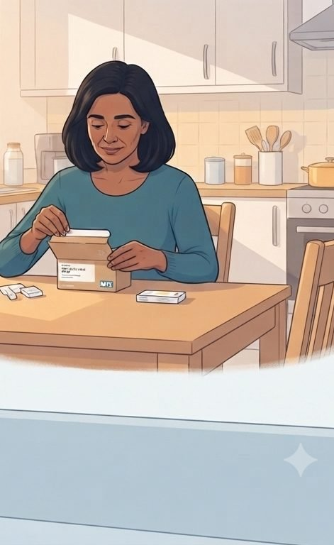
ANITA'S JOURNEY · STAGE 5 OF 6
05
Live operation · kits out
results back
First quarter live at the pilot federation. Kits going out to at-risk register patients due their annual HbA1c review. Results returning into the GP record ahead of review consultations. QOF DM006 auto-linkage running. Register completion rate ticking up. The pathway holds. Second and third federations due to activate over the next two quarters against the same call-off.
“Patients don't see commissioning. They see a kit in the post and their GP opening the annual review with the number already in front of them. The pathway holds.” Anita
WHAT THE MODEL IS DOING UNDERNEATH
THE OLD WAY
The MI dashboard. Kits ordered. Kits delivered. Results returned. Register-completion rate. HbA1c trend movements. Diabetes Prevention Programme referral triggers. Practice nurse minutes released per patient. Federation-level utilisation across her ICB. Equity reach across her deprived wards. Reactive support paths for out-of-range results. The numbers are visible in real time. Anita doesn't need to wait for the annual return.
Federation-by-federation MI. Manual reconciliation to see the ICB-level picture. Manual chasing of register completion rates. No comparable view across her federations until the annual report. The risk: finding out a year late that the pilot federation's register drift was masking a system-level issue.
WHO ANITA'S CARE TEAM SEES GPs across her federations running annual reviews. The supplier running the kit logistics. The platform running the data layer with GP-record write-back. Each federation's clinical governance running local safety oversight. Anita looking at the ICB-level MI feed weekly.
Hearts and Minds · Anita's journey · HomeTest operating model · September 2026
Commercial positions are agreed in principle and remain subject to the live procurement.
7
Notes:
Stage 5: Live operation · kits out. The MI dashboard. Kits ordered. Kits delivered. Results returned. Register-completion rate. HbA1c trend movements. Diabetes Prevention Programme referral triggers. Practice nurse minutes released per patient. Federation-level utilisation across her ICB. Equity reach across her deprived wards. Reactive support paths for out-of-range results. The numbers are visible in real time. Anita doesn't need to wait for the annual return.

Slide 8
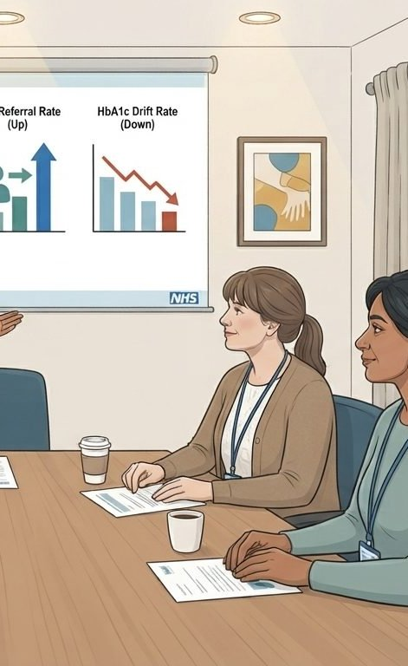
ANITA'S JOURNEY · STAGE 6 OF 6
06
The ICB paper · what the CMO sees
What the members see
First-year outcomes across the ICB. Register-completion rate up. QOF DM006 achievement up. Practice nurse minutes released. Diabetes Prevention Programme referral triggers detected earlier. Federation-by-federation adoption curve. The ICB paper writes itself. The next year's ask is for the next primary-care annual-review test, not the next procurement.
“The Chief Medical Officer wanted to know whether the register held. The numbers do most of the talking. The register-level commissioning behind them is what made the numbers possible.” Anita
WHAT THE MODEL IS DOING UNDERNEATH
THE OLD WAY
Register-completion rate against the ICB baseline. HbA1c trend detection at pre-diabetes threshold. QOF DM006 achievement. Practice nurse minutes released per register patient per year. Diabetes Prevention Programme referral pipeline strength. Patient-reported experience. Reactive-pathway performance for out-of-range results. The recommendation for year two: extend to the next primary-care annual-review test the platform admits. Same framework. Same call-off shape. Same MI feed.
An ICB paper hedged with per-federation data still maturing. Three years before an ICB-level pattern could be evaluated. By which time the pilot federation's clinical director had rotated, the funding envelope had shifted, and the register had drifted.
WHO ANITA'S CARE TEAM SEES The ICB Chief Medical Officer. The ICB executive committee. GP clinical directors across her federations. The ICB finance team setting the next year's primary-care envelope.
Hearts and Minds · Anita's journey · HomeTest operating model · September 2026
Commercial positions are agreed in principle and remain subject to the live procurement.
8
Notes:
Stage 6: The ICB paper · what the CMO sees. Register-completion rate against the ICB baseline. HbA1c trend detection at pre-diabetes threshold. QOF DM006 achievement. Practice nurse minutes released per register patient per year. Diabetes Prevention Programme referral pipeline strength. Patient-reported experience. Reactive-pathway performance for out-of-range results. The recommendation for year two: extend to the next primary-care annual-review test the platform admits. Same framework. Same call-off shape. Same MI feed.

Slide 9
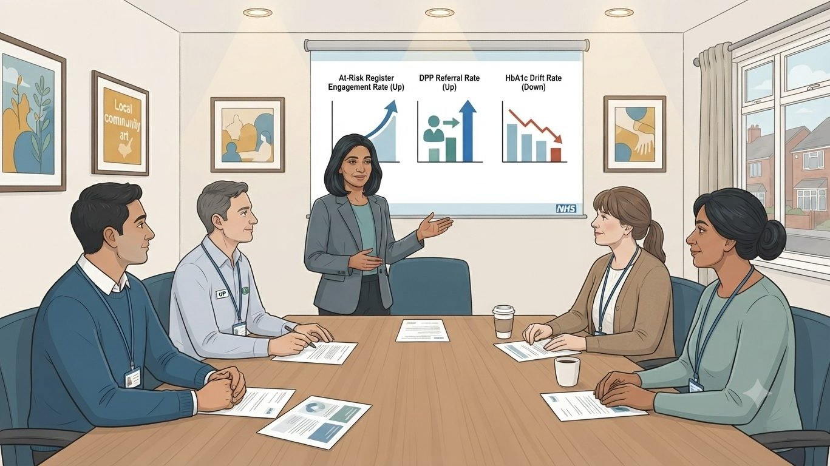
ANITA'S WIN
Register cadence held across her federations. Practice nurse minutes released. Pre-diabetes triggers detected earlier.
THE MONEY IN THIS STORY
Anita's register makes her demand predictable, and predictable volume is negotiating strength. Her call-off prices each completed review against the national ceiling, and the system pays only for reviews that happen, not for clinic sessions booked against people who could never attend them. She pays the supplier direct from the annual review budget that already exists. The unit she manages stops being the appointment and becomes the result.
The at-risk register patients didn't see commissioning. They saw a kit in the post and their GP opening the annual review with the number already in front of them. The eighteen months Anita didn't spend stitching federation deals is the eighteen months her register didn't drift. The next primary-care annual-review test is an extension of the same signature, not a new arrangement from a clean sheet.
Commission at register scale. So the annual HbA1c review cadence holds across the at-risk cohort without pulling clinic slots.
Anita
ICB / GP commissioner · HomeTest HbA1c
Hearts and Minds · Anita's journey · HomeTest operating model · September 2026
Commercial positions are agreed in principle and remain subject to the live procurement.
9

Slide 10
Anita
ICB / GP commissioner · HomeTest HbA1c
Commission at register scale. So the annual HbA1c review cadence holds across the at-risk cohort without pulling clinic slots.
Hearts and Minds · Anita's journey · HomeTest operating model · September 2026
Commercial positions are agreed in principle and remain subject to the live procurement.
10

